Slide 1
Wireless for the Internet of Things IoT Cellular, Backscatter, Matter
CS/ECE 4501
Spring 2023
UVA
[Pannuto, Ghena, Campbell]

Slide 2
Today’s Goals
Wrap up cellular discussion
Understand how cell companies want to support the IoT market
Introduce backscatter
RF-based technique for low power communication
Discuss Matter
Future of smart home?

Slide 3
Outline
IoT Cellular
Backscatter
RFID
IoT Backscatter
Matter

Slide 4
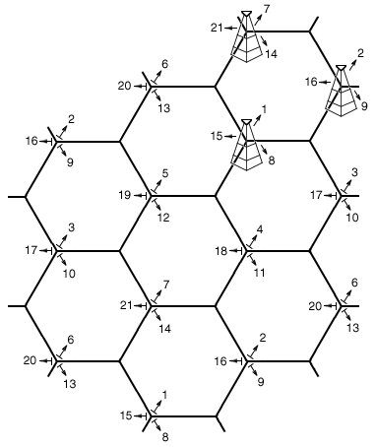
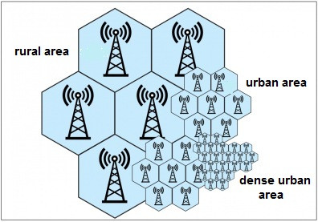
Reminder: the cell in cellular technologies
Place towers at corners of cells
Directional antennas send three different frequency bands, one per cell
Each cell gets three tower and three bands
Density of cells varies based on expected number of users
Change cell size using Power Control

Slide 5
3GPP (aka: the actual answer for what stuff is really doing)
3rd Generation Partnership Project (3GPP)
Industry alliance for development of telecoms standards
Established around 1998
Makes “Releases” which are roughly analogous to IEEE standards/versions
Release 8 (2008) LTE ~4G
Release 15 (2018) NR (New Radio) ~5G
Focused on the practical
ITU post-hoc defined “4G”, 3GPP defined LTE

Slide 6
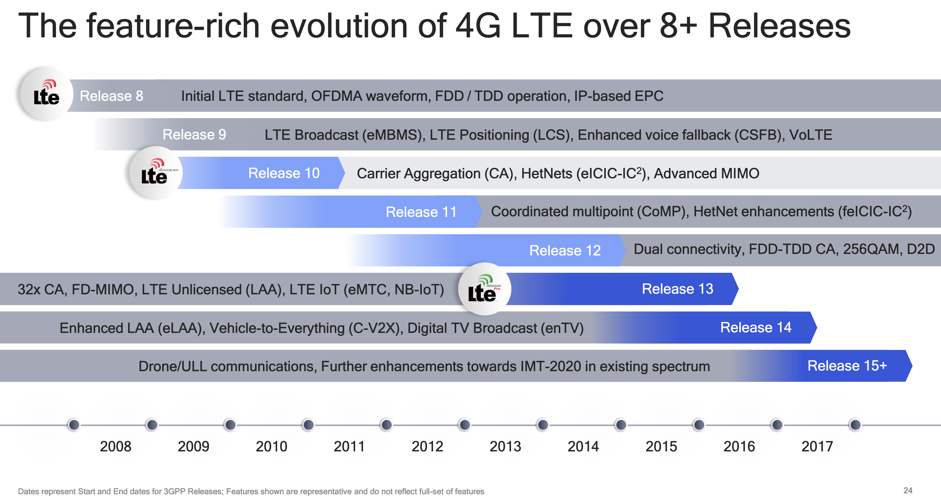
Mapping ”4G”, “LTE”, “LTE Advanced”, etc onto actual technologies
This Qualcomm presentation is great: https://www.qualcomm.com/media/documents/files/demystifying-3gpp-and-the-essential-role-of-qualcomm-in-leading-the-expansion-of-the-mobile-ecosystem.pdf

Slide 7
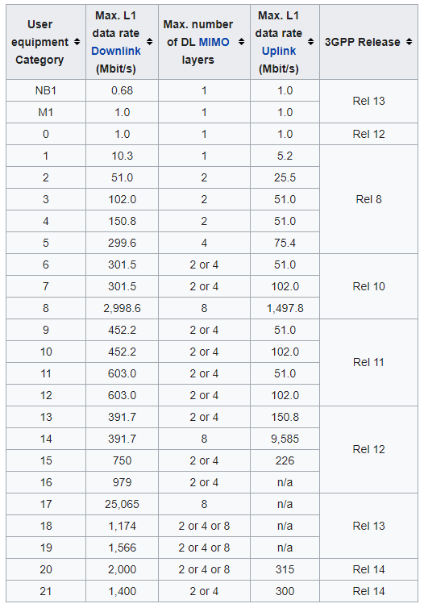
LTE Categories
Different equipment supports different “categories” of LTE
Maximum MCS index supported
Examples
iPhone 6 (2015): Cat 4
Pixel 3 (2018): Cat 16
Notes:
MCS = Modulation Coding Scheme
https://mcsindex.com/ looks like all the tables for WiFi; not clear whether this is the same for cell

Slide 8
Additional low-end categories for IoT
LTE-M (LTE Cat M1)
375 kbps uplink, 300 kbps downlink (for the actually implemented mode)
Reduced power and maximum bandwidth
Increased range
NB-IoT (LTE Cat NB1)
65 kbps uplink, 26 kbps downlink
Reduced power and greatly reduced bandwidth
Greatly increased range

Slide 9
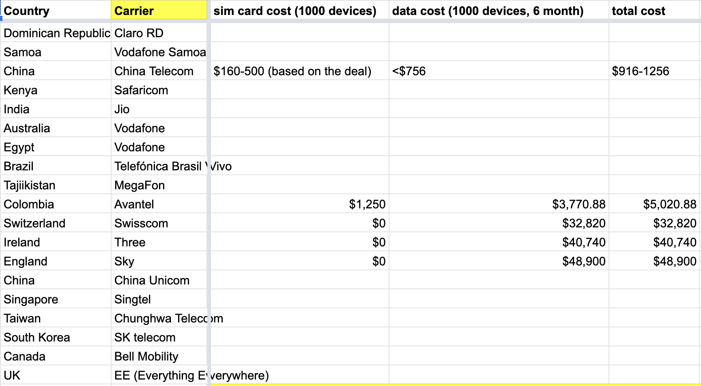
Why do we need “special categories” for IoT on cell?
Pragmatic for the end device
Lower power
Allow for long-off periods
Pragmatic for network operators
Allows for scale: network no longer needs to assume that devices could always be on in each cell

Slide 10
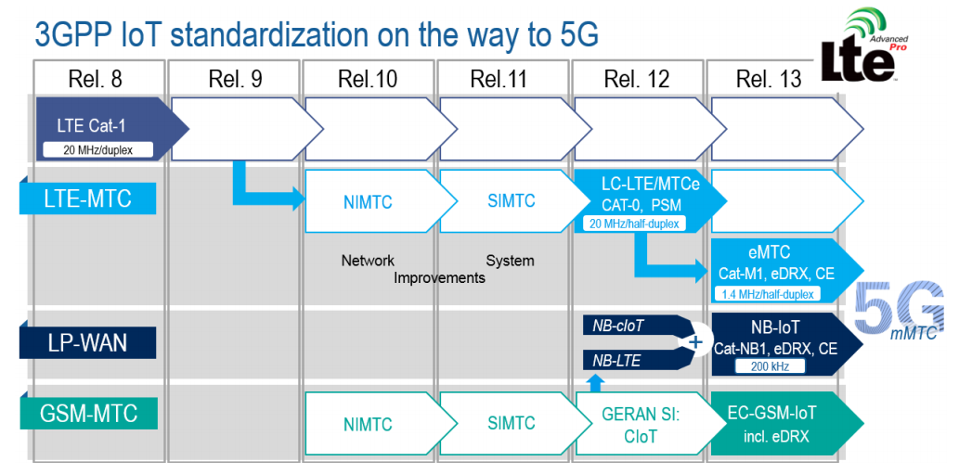
LTE-M and NB-IoT were developed in parallel

Slide 11
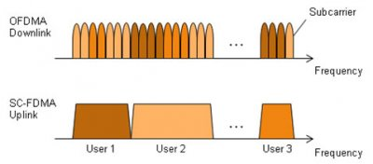
LTE-M and NB-IoT downlink and uplink
OFDMA downlink
Put the more complicated hardware in the cell tower [simple FFT demodulator]
SC-FDMA (single carrier FDMA) uplink
Blocks of subchannels combined into one signal
Similar concept, but simpler for end devices to implement

Slide 12
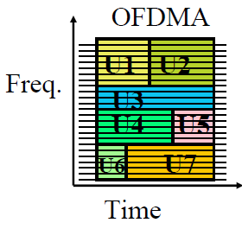
LTE resource allocation
Cellular uses OFDMA to schedule
Time + Frequency -> “2D Scheduling”
Cellular uses single channels up to 20 MHz
Further divides these into 100 Resource Blocks
Resource Block
12 subcarriers for OFDM in frequency (15 kHz each)
7 symbols in time (0.5 ms)
Devices are allocated frequency and time based on what they are sending
Allocated in units of Resource Blocks

Slide 13
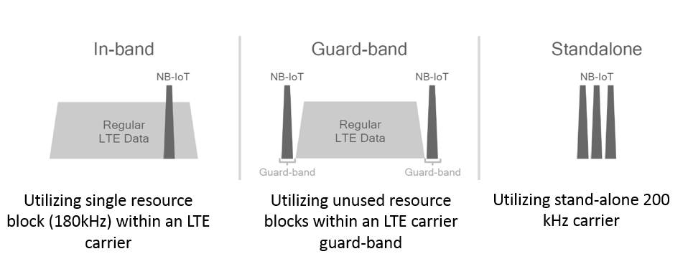
Resources used by LTE-M and NB-IoT
LTE-M uses up to 6 resource blocks
1.4 MHz of bandwidth (1.080 MHz)
Can co-exist with other normal LTE traffic, scheduled by cell tower
Limited to only some capability of LTE
NB-IoT uses up to 1 resource block
200 kHz of bandwidth (180 kHz)
Multiple deployment options
Guard-band in practice

Slide 14
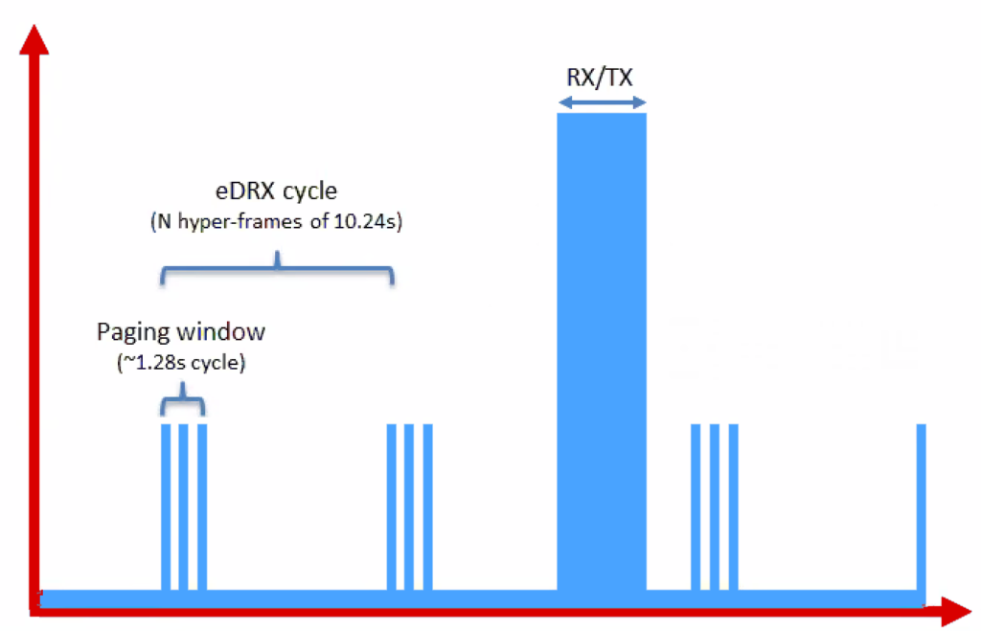
Reducing power for IoT devices
Reduce max Tx power to 20 dBm
Increased receive sensitivity at tower will cover it
Extended Discontinuous Reception (eDRX)
Allow devices to reduce paging period and still stay on network
Cell tower will hold messages
What does this get to?
“For a LTE-M1 device that transmits data once per day, and wakes up every 60 hyper frames to check for commands (this would be about every 10 minutes), a life of 4.7 years is achievable on 2 AA batteries.”
Graphics, quote from https://www.link-labs.com/blog/lte-e-drx-psm-explained-for-lte-m1

Slide 15
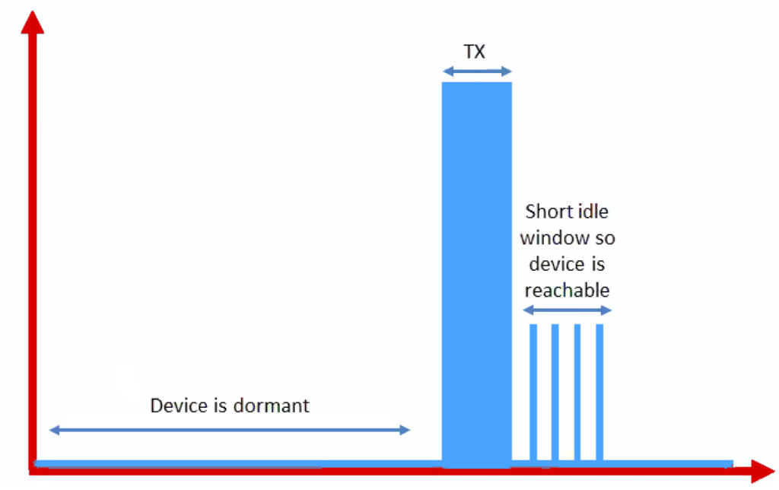
Further power reduction for simple devices
Power Saving Mode (PSM)
For very simple, uplink-focused devices, allow them to turn off entirely but stay connected
Minutes to days in duration
Notify tower before sleeping, listen for packets after each transmission
Graphics from https://www.link-labs.com/blog/lte-e-drx-psm-explained-for-lte-m1

Slide 16
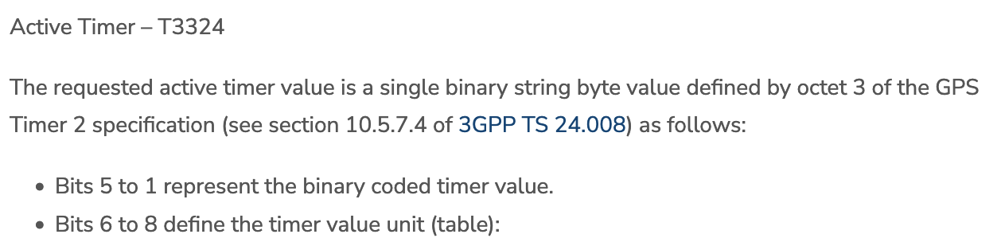
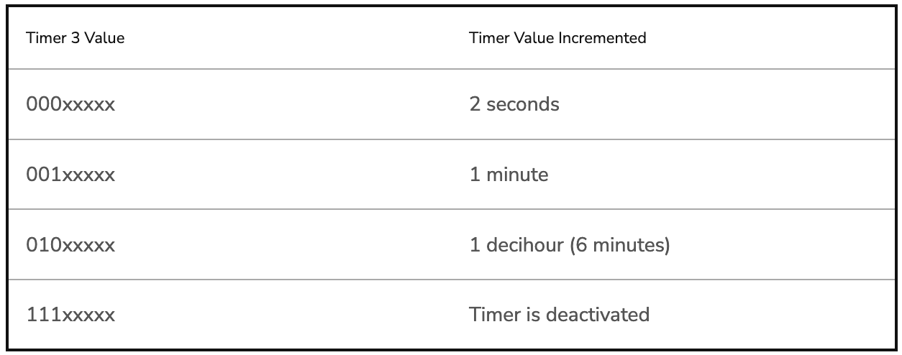
Some numbers from an actual telecom: Aeris [n.b. Aeris has been a leader in cellular M2M since the 90’s]
PSM has two timers, devices request values, tower chooses actual:
Extended Timer (“sleep” timer)
3GPP max is 35,712,00s [413.33 days]
Aeris timer range: Min 240m [4h]; Max 413 days
“Aeris Fusion” timer range: Max: 12.9 days
Active Timer (how long will the device stay in idle after communication?)
Numbers from https://aeriscom.zendesk.com/hc/en-us/articles/360049848254-Understanding-LTE-M-Power-Management-Modes
Notes:
Really hard to tell difference between Aeris and Aeris Fusion. I think Aeris Fusion is a new product that allows devices (same SIM?) to dynamically switch between an IoT profile and a full-fledge voice / high-bw data profile. My guess then is that Aeris network is all their own owned infra, and Fusion is them acting as an MVNO [thus limited to others for wakeup range]

Slide 17
Improved range for LTE-M and NB-IoT
LTE defines a Maximum Coupling Loss (MCL) a.k.a Link Budget
Traditional cellular: 144 dB (~2.5 km)
LTE-M: 160 dB (~5 km)
NB-IoT: 164 dB (~10 km)
Sigfox: ~155 dB
LoRaWAN: ~143 dB
Note that many cellular bands are often on higher frequencies
Example: 1900 GHz

Slide 18
Coarsely, lower frequency -> longer range
This was the picture circa 2019
Why else might T-Mobile have really wanted to buy Sprint…

Slide 19
Cellular deployments
Originally unclear which would be dominant
Verizon and AT&T focused on LTE-M
T-Mobile focused on NB-IoT
All rolled out services nationwide in the 2018-2019 timeframe
Networks are expanding to provide both capabilities
LTE-M: AT&T, T-Mobile, US Cellular, Verizon
NB-IoT: AT&T, T-Mobile
Pricing models still very uncertain
NB-IoT example: $5 per device per year up to 12 MB, 10 packets per hour
Future adoption will greatly depend on these

Slide 20
Outline
IoT Cellular
Backscatter
RFID
IoT Backscatter
Matter

Slide 21
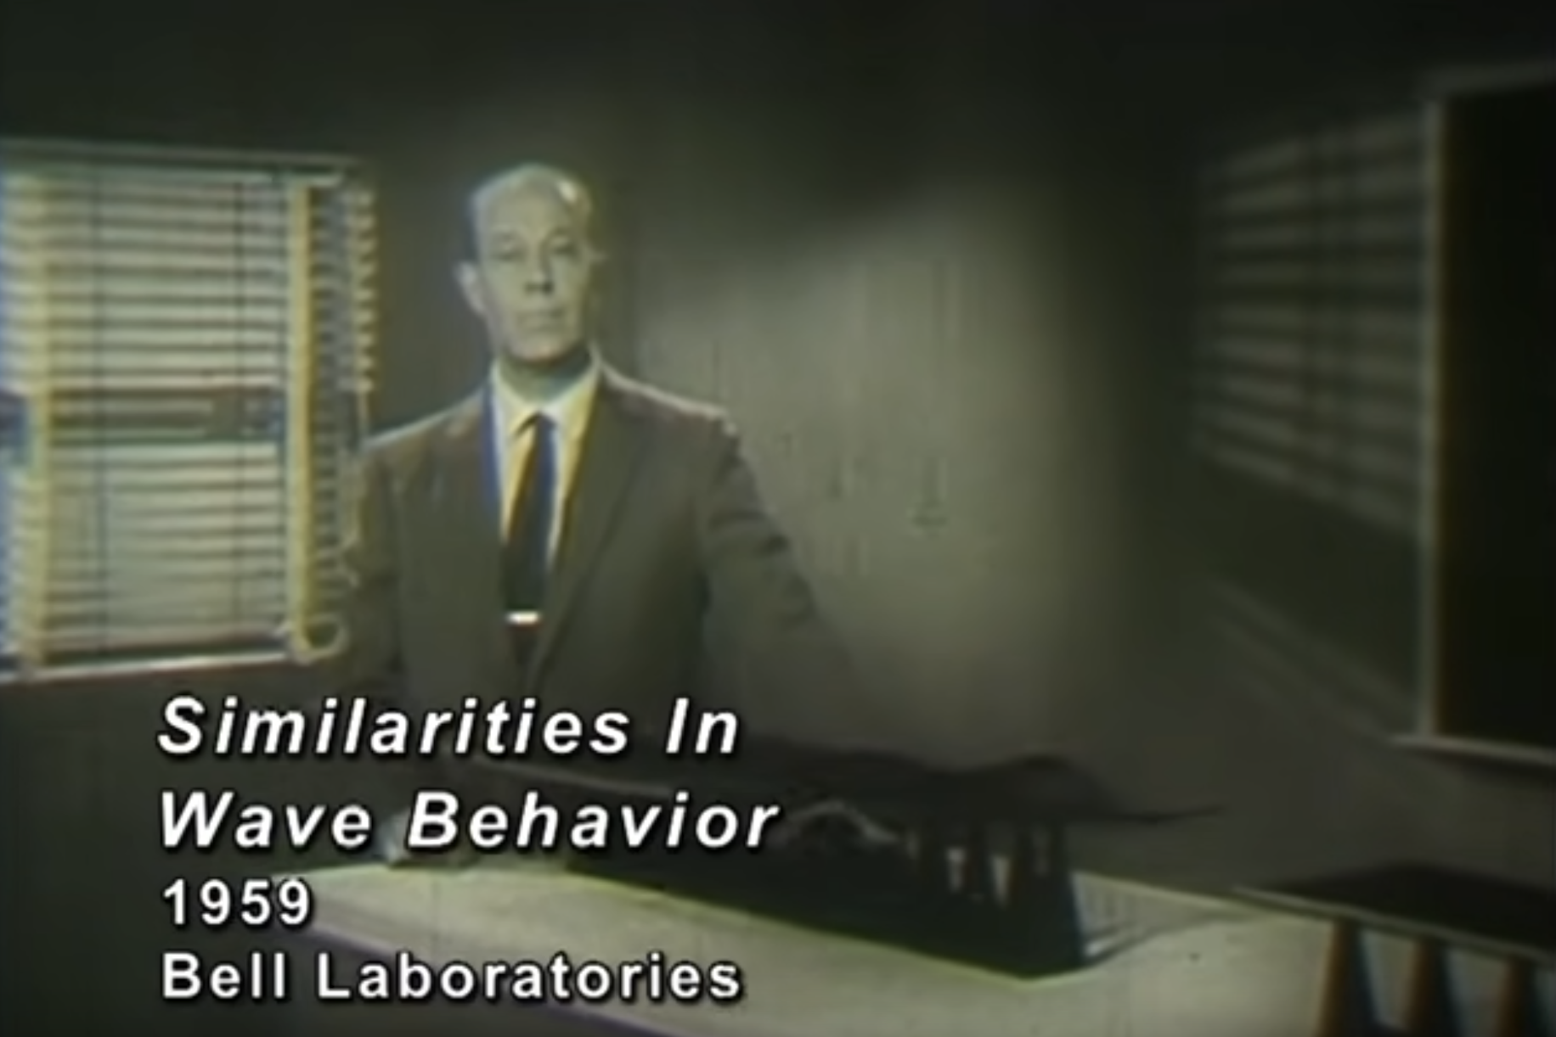
Resources
This Bell Labs instructional video from 1959 is excellent background:
https://www.youtube.com/watch?v=DovunOxlY1k

Slide 22
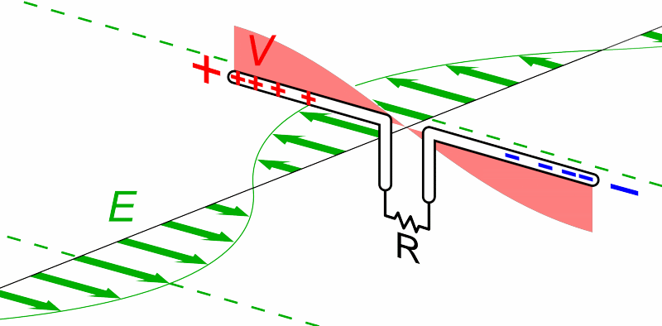
What does an antenna do?
Loosely: Converts between electric and magnetic waves
Animation by Chetvorno - Own work, CC0, https://commons.wikimedia.org/w/index.php?curid=40789783

Slide 23
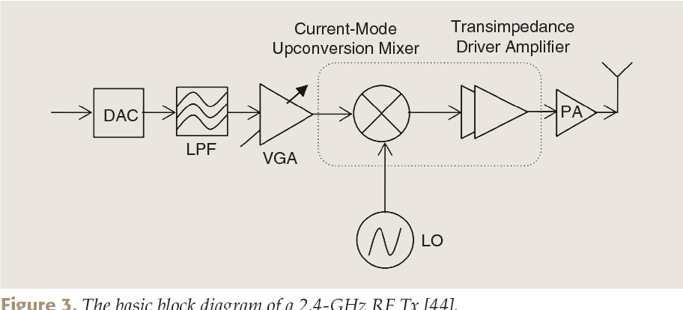
What generates electric waves?
RF front end
can be done with high-speed digital components (e.g. fast DACs)

Slide 24
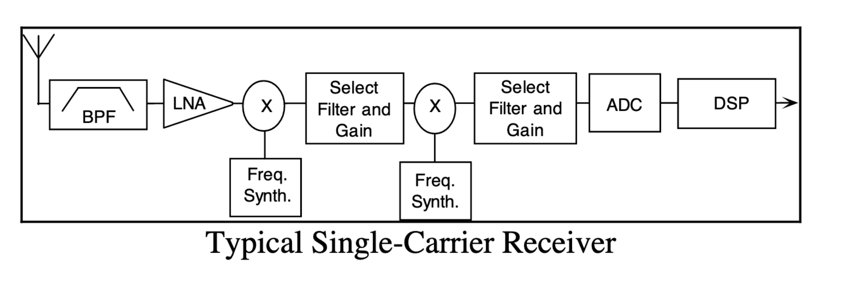
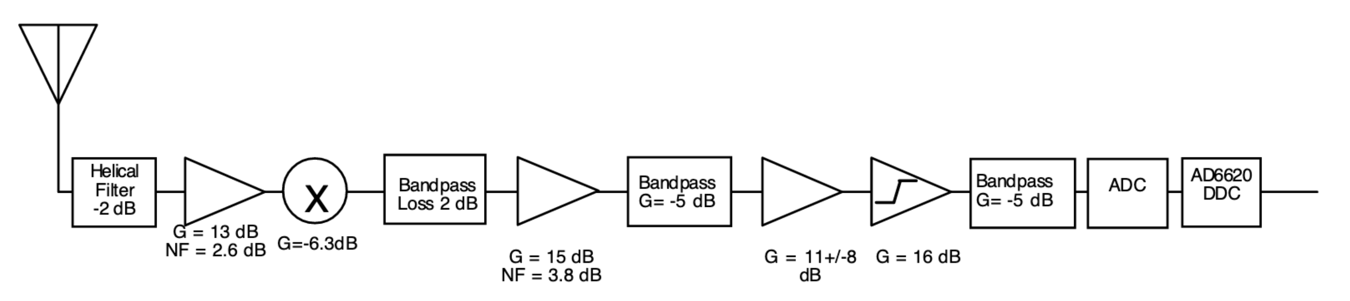
What receives electric waves?
Could be a high-speed ADC, more often with analog pieces in front:
Graphics from Analog Devices whitepaper: https://www.analog.com/media/en/technical-documentation/tech-articles/480501640radio101.pdf — significantly more detail here

Slide 25
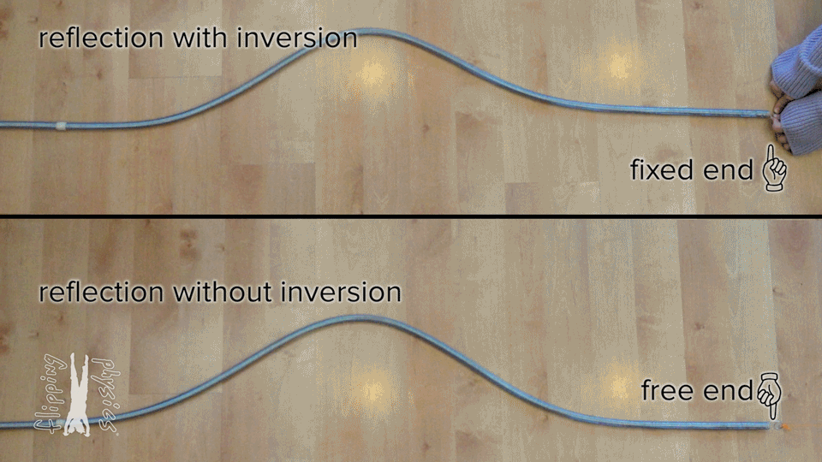
What happens if nothing ‘receives’ the wave?
From: https://www.flippingphysics.com/standing-waves.html

Slide 26
“Fixed end” and “Free end” in electronic transmission
~
Short Circuit = “Free End”
- Reflects wave
~
Open Circuit = “Fixed End”
- Inverts wave
~
Matched Load
- Absorbs wave (no reflection)

Slide 27
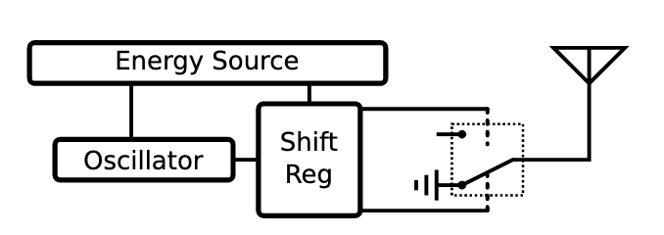
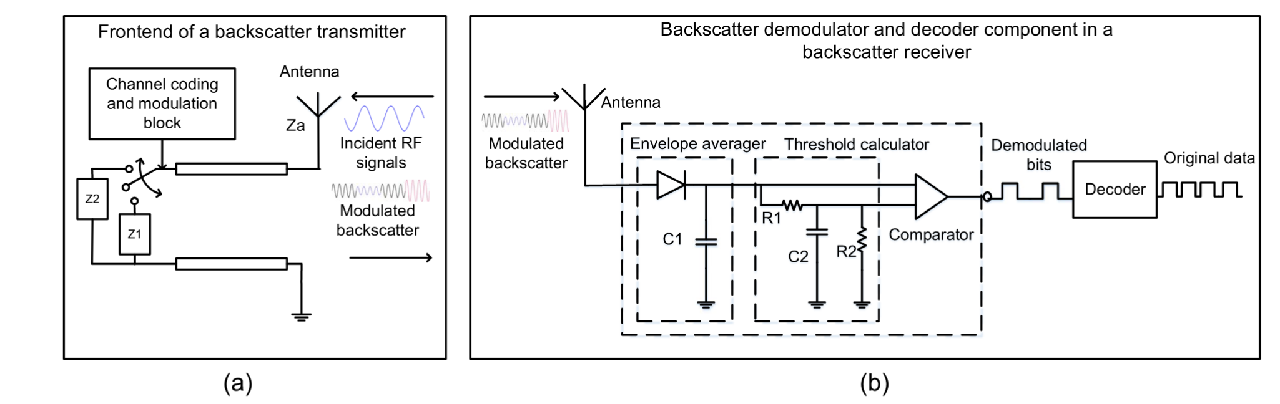
Backscatter systems reflect waves rather than generate waves — significant (10,000x or more) power savings
Simple versions just ‘reflect or don’t reflect’
Modern designs can do more advanced modulation as well
https://ieeexplore.ieee.org/stamp/stamp.jsp?arnumber=8368232

Slide 28
Backscatter is an old idea — history in spycraft!
1945: Leon Theremin* creates “The Thing” (aka Great Seal Bug)
*Yes, same guy who invented the instrument
Discovered when a British embassy radio operator heard recorded conversations

Slide 29
Outline
IoT Cellular
Backscatter
RFID
IoT Backscatter
Matter

Slide 30
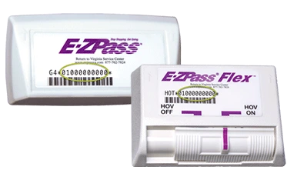
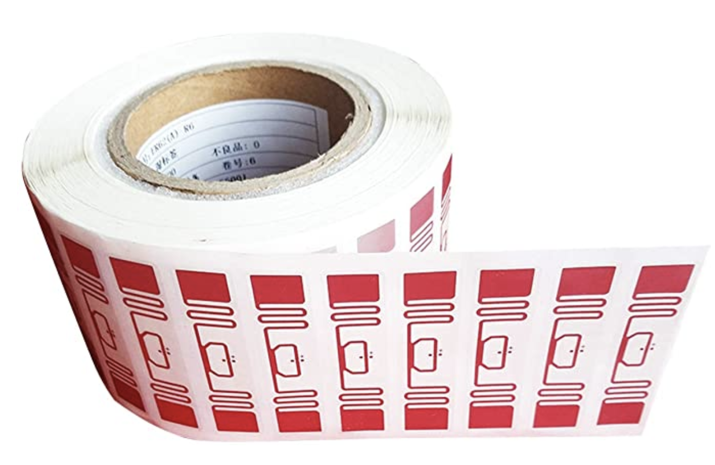
RFID is everywhere nowadays
Fundamental design principle is asymmetry
Extremely simple, cheap tags
Complex readers

Slide 31
A brief digression to be precise in terminology
RFID = Radio Frequency Identification = “a” communication standard
A ton through ~early 90’s; “EPC” ~= UPC, standardized; most now EPC Gen2
There are actually three types of “RFID” device
Passive Tags - harvest power from reader & reflect
Semi-Passive Tags - on-board power, but reflect data
Active Tags - on-board power that transmit data
These are ”backscatter” — which describes any communication via reflected RF
Notes:
The point: Papers misuse “RFID” to mean backscatter, and misuse “passive tag” to mean anything that doesn’t actively emit RF.
Most things that do backscatter don’t do the energy harvesting bit
Many papers that do backscatter describe themselves as RFID, but don’t follow any RFID communication standard

Slide 32
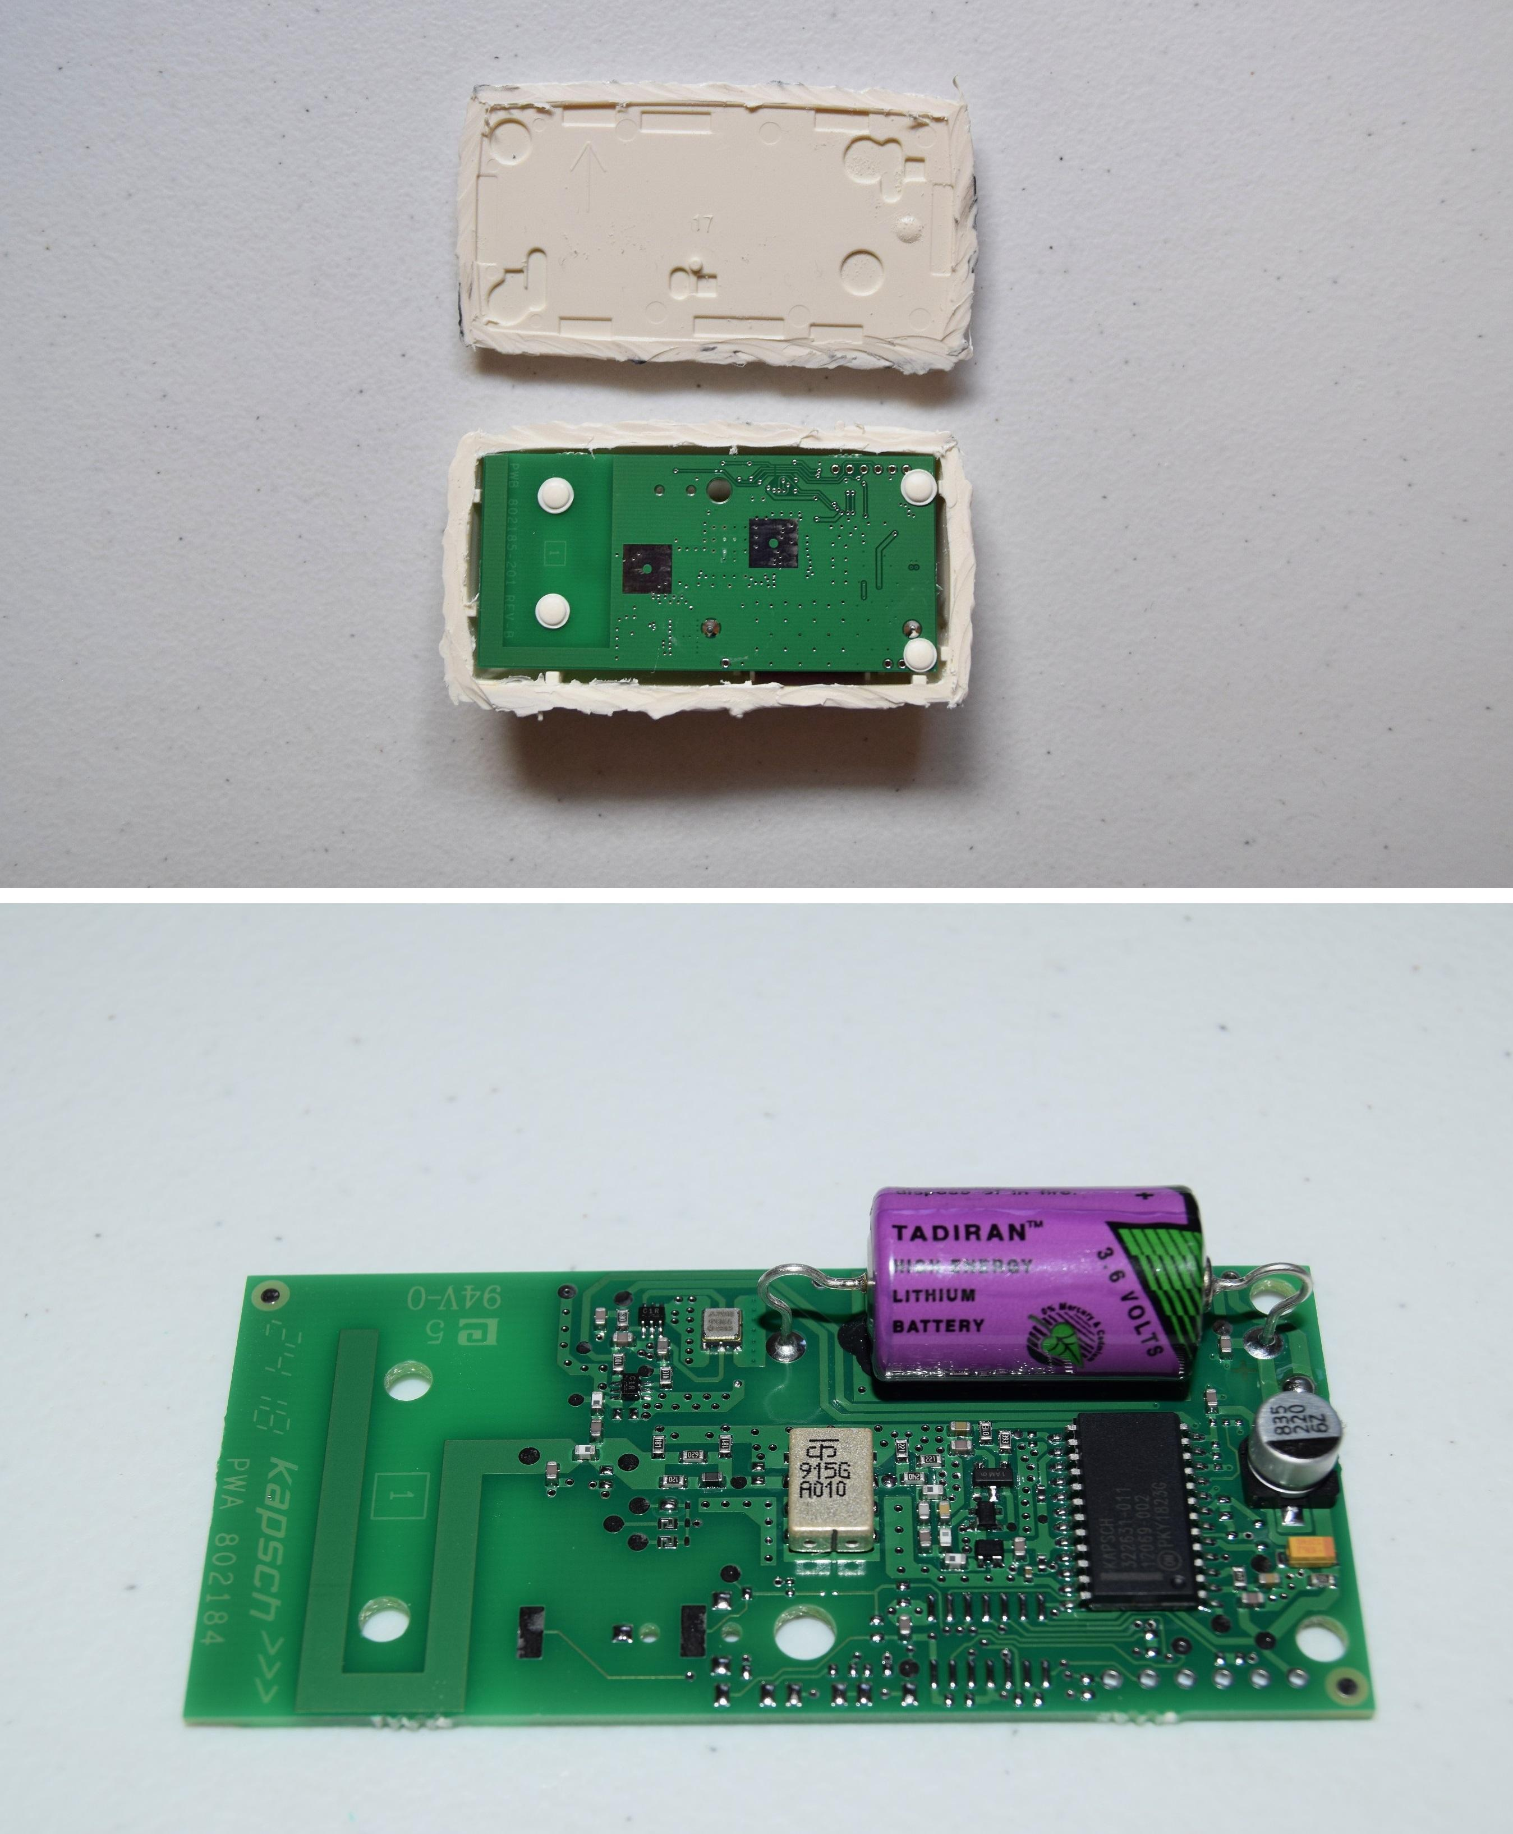
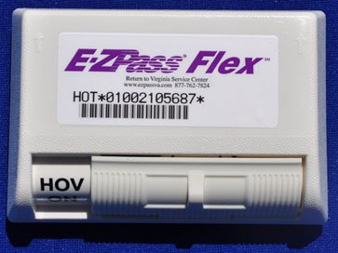
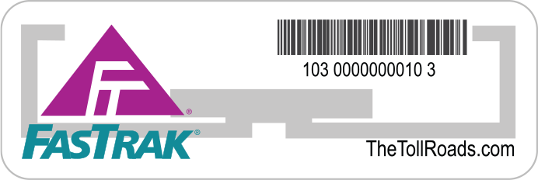
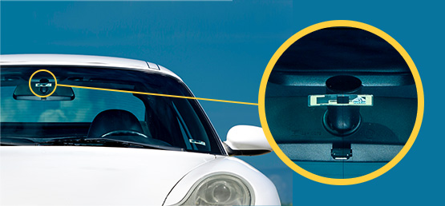
The meaningful difference is in how the tag devices power themselves
Even on simple designs, need some power:
Let’s look at E-ZPass again:

Slide 33
Let’s look at RFID standards to get a sense of the numbers
Low Frequency (~300 kHz) — mostly legacy
~10cm read range
High Frequency (3~30 MHz; often 13.56 MHz)
Passive: 4~7 m max
Semi-Passive: 10~30 m max
Active: 30+ m
Ultra-High Frequency (300 MHz ~ 3 GHz)
Passive: Up to 12 m
Active: Up to 100 m

Slide 34
Sidebar: What’s NFC?
Near Field Communications is a subset of the RFID protocol
10-20cm range (usually <10)
Inductively coupled loop antennas
Communicates via local magnetic field rather than electromagnetic waves
This is the “near-field” part
(Basically a transformer)
Note, does still emit RF, just weakly (i.e. can be eavesdropped on from afar)

Slide 35
Outline
IoT Cellular
Backscatter
RFID
IoT Backscatter
Matter

Slide 36
“Embedded” sensors
How do you change batteries in a device that’s inside a wall or inside someone’s body?

Slide 37
Backscatter for sensor networks
Conventional
Radio
Backscatter
Transmissions
Backscatter Tag
Backscatter allows transmissions at up to 10000x lower power than conventional radios
Makes it very attractive for low-energy sensing devices

Slide 38
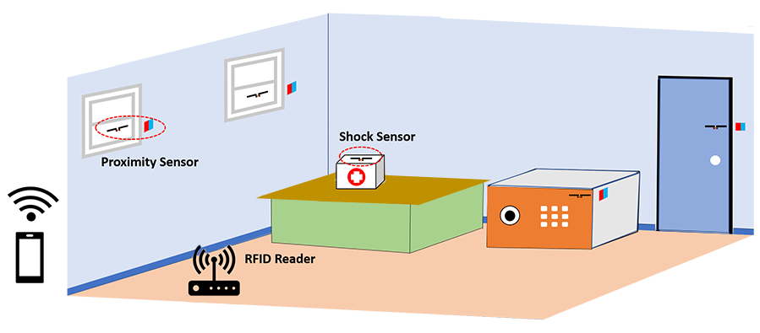
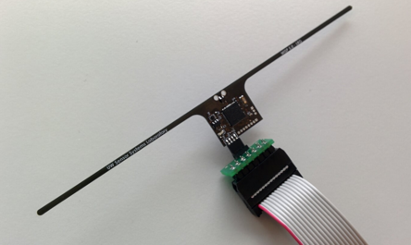
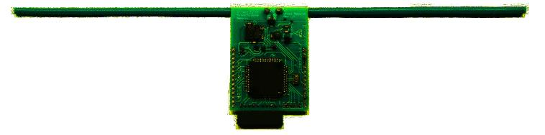
RFID sensors
First iterations were literally RFID sensors
Limited by cost and range of RFID readers (only a few meters)
WISP 5.0
University of Washington
Moo 1.0
University of Massachusetts

Slide 39
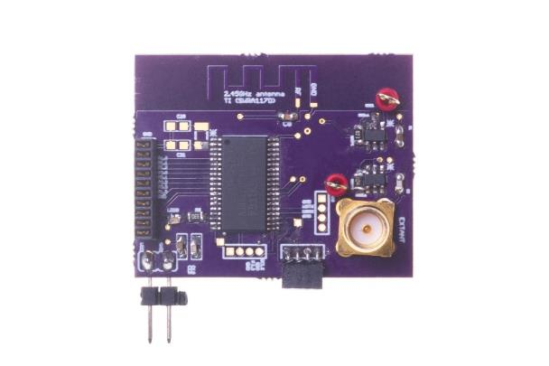
Backscatter + LPWAN = usable?
Idea:
Backscatter is about low energy operation
LPWANs are about long-range operation
Can we combine them for low energy and medium-long range?
LoRea: long-range transmissions at μW
Varshney et al. ”LoRea: A Backscatter architecture that achieves a long communication range” SenSys 2017

Slide 40
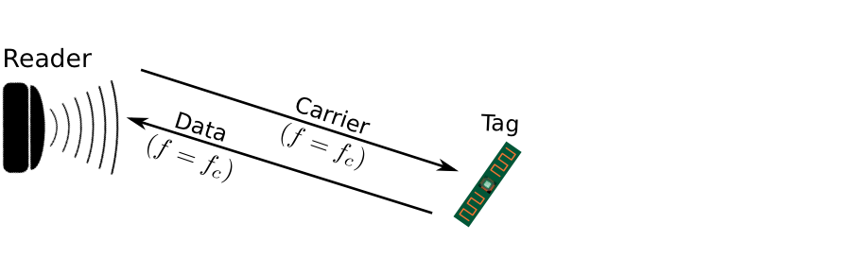
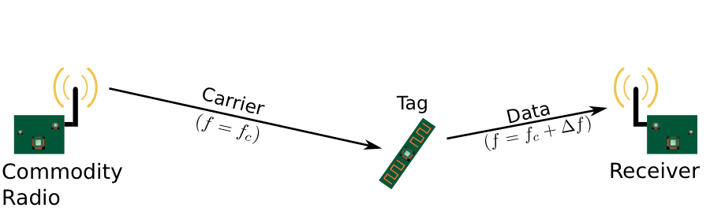
Design element #1: LoRea decouples the carrier signal generation and reception
Bi-static setup spatially separates carrier generation from the receiver
Use devices that surround us for providing the necessary carrier signal
Self-interference reduced due to path loss suffered by carrier signal
Monostatic configuration
Bi-static configuration
Notes:
+ If we look into a RFID reader's configuration, there is a single device that both receives the backscatter transmissions and generates the necessary carrier signal. This is called a monostatic configuration.
+ In LoRea, we decouple the task of carrier signal generation and the reception of the backscatter transmissions. We adopt a bistatic configuration as we show in the slide. We have a dedicated device for carrier signal generation and reception.
+The advantage of the bistatic configuration is two-fold: First, we can attenuate the carrier signal arriving at the receiver due to the path loss suffered due to the propagation of the wireless signal. This helps us reduce interference from stronger carrier signal to much weaker backscatter transmission. Second, it also enables us to use the devices that surround us, such as smartphones or wifi router, as sources for providing the necessary carrier signal to support backscatter transmissions. In fact, in lorea, we demonstrate the use of these devices to provide the carrier signal.’

Slide 41
Design element #2: LoRea backscatters at a frequency offset from the carrier signal
Backscatter is a mixing process
Transceivers attenuate interference at adjacent frequency channels
Frequency separation reduces interference from carrier to backscatter signal
No complex self-interference mechanisms required at reader
Notes:
+ The second design element that we incorporate in the design of LoRea is that we create separation in frequency between the carrier signal and the reflected transmissions. We transmit the backscattered signal at a particular offset from the carrier signal. This is unlike systems such as RFIDs that transmit at the same frequency as the carrier signal, requiring complex and expensive self-interference cancellation mechanisms.
+ To backscatter at an offset from the carrier signal, we take advantage of the property that the backscatter is a mixing process. If a carrier signal is incident on the backscatter tag, and if we toggle the antenna, i.e., change the antenna's state between absorption and reflection state at a frequency delta f, we can now create backscatter transmissions at a frequency offset of Fc+delta F due to the mixing property.
+ Most modern radio transceivers have bandpass filters present in adjacent frequency bands. They support these to enable co-existence on the shared wireless spectrum to suppress interference from adjacent traffic. We use these filters to our advantage; we place the carrier signal in the bandpass filter and significantly attenuate the carrier signal.
+ By incorporating the decoupling in space and frequency, we can reduce the interference to the weak backscatter transmissions from stronger carrier signal by up to 50-70 dB. We do not need to employ any complex self-interference cancellation mechanisms that are used on existing RFID readers. We use off-the-shelf commodity transceivers that just cost a few usd to carrier generation and the reception, thus significantly lowering the infrastructure's cost and complexity to support backscatter transmissions.

Slide 42
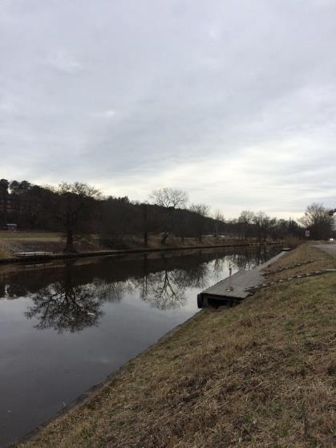
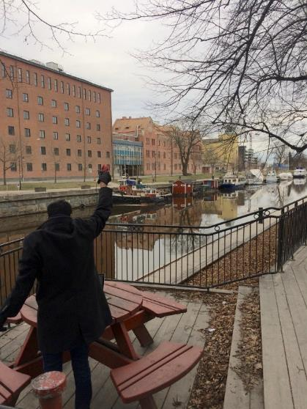
Ran out of space while performing experiments
State-of-art few meters. We achieved kilometers, was difficult to anticipate
Initial experiments conducted near the university and a river
Experiment Setup
Receiving transmissions 1km away from the setup

Slide 43
LoRea outperforms state-of-the-art systems
System name | Communication range
LoRea – 868 MHz (SENSYS 2017) | 3400 m
LoRea – 2.4 GHz (SENSYS 2017) | 225 m
RFID | < 18 m
BackFi (SIGCOMM 2015) | 5 m
Passive WiFi (NSDI 2016) | 30 m
HitchHike (SENSYS 2016) | 54 m
Interscatter (SIGCOMM 2016) | 30 m
LoRa Backscatter (UBICOMP 2017) | 2800 m
Range reported are line of sight, with backscatter tag co-located with carrier source

Slide 44
Future research directions for backscatter sensor communication
Improve capabilities for “ambient” backscatter
Reuse existing RF signals rather than relying on carrier generation
MAC layers for backscatter
Need ability to communicate with very low power
How do you manage access to the medium?
Real-world usable backscatter stacks and hardware
Needs to be deployable and usable by non-experts

Slide 45
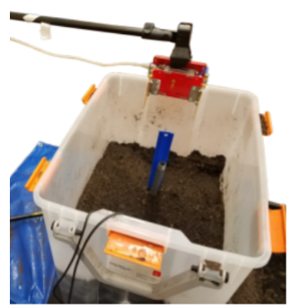
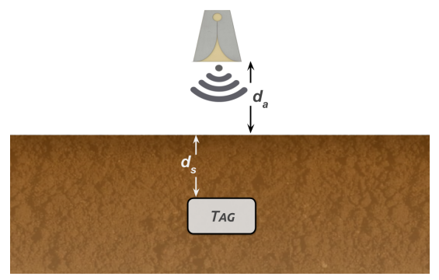
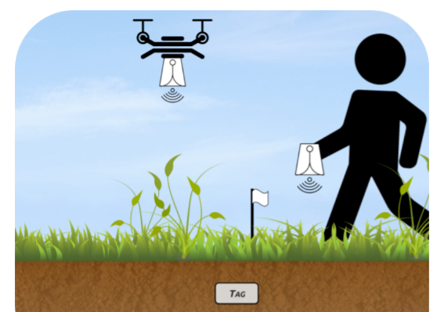
Backscatter as a sensor: soil moisture
Idea: bury backscatter tags in soil
Measure round-trip-time for signal to reflect
T_{s} (time signal travels through ground) changes based on the moisture in the soil
Josephson, Colleen, et al. "Low-cost In-ground Soil Moisture Sensing with Radar Backscatter Tags.“ COMPASS 2021

Slide 46
Outline
IoT Cellular
Backscatter
RFID
IoT Backscatter
Matter

Slide 47

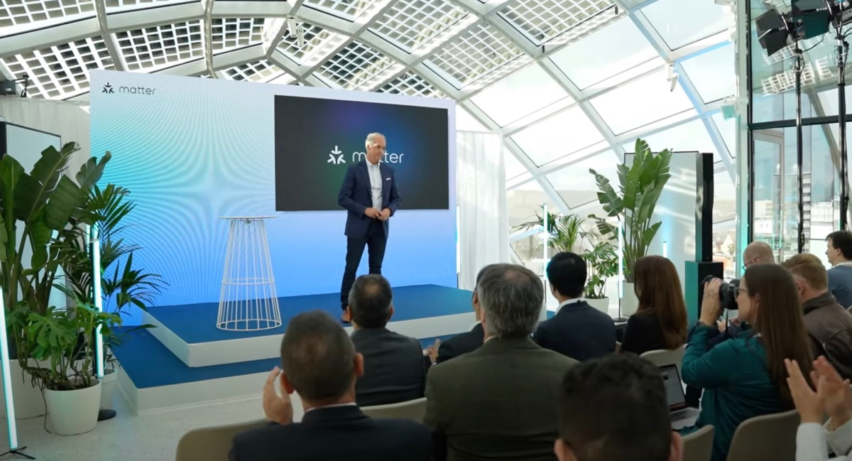
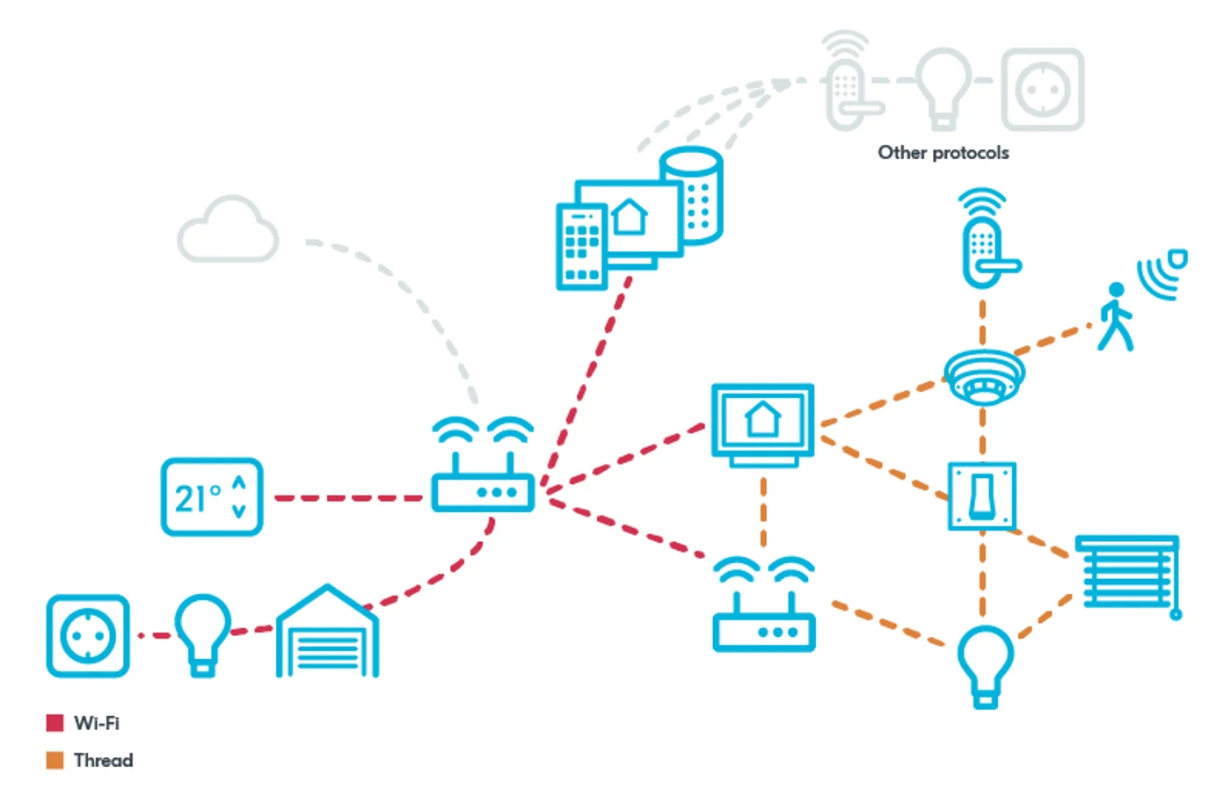
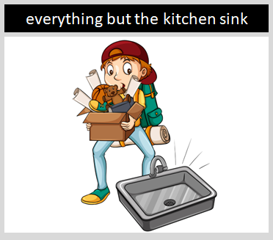
CES 2023
The foundation for connected things
A seal of approval that devices will work seamlessly together today & tomorrow
Simplifying development for manufacturers and increasing compatibility for consumers.

Slide 48
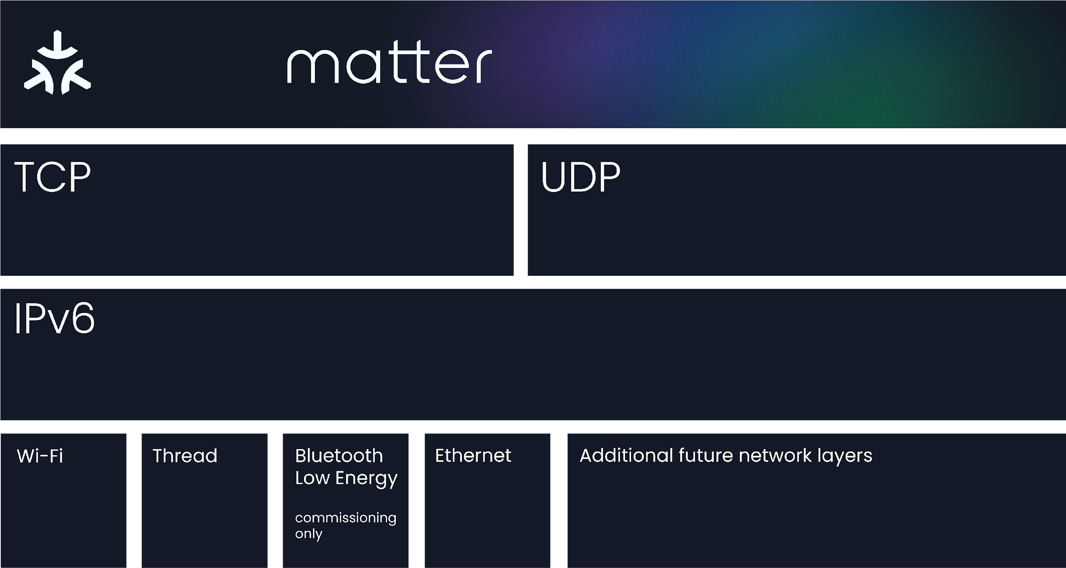
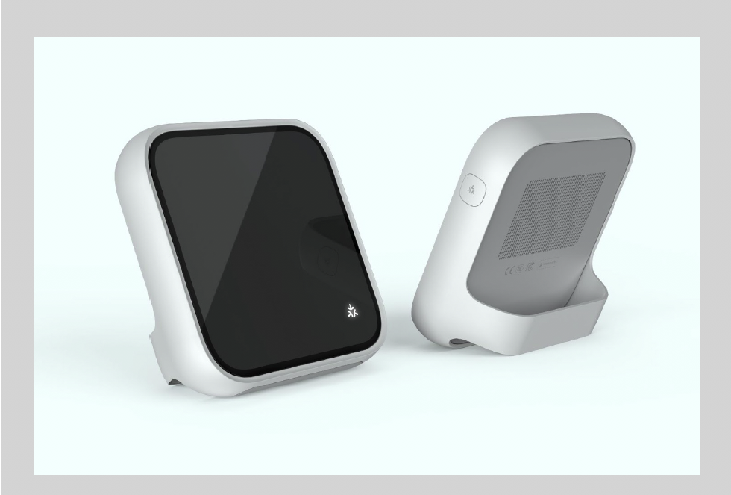
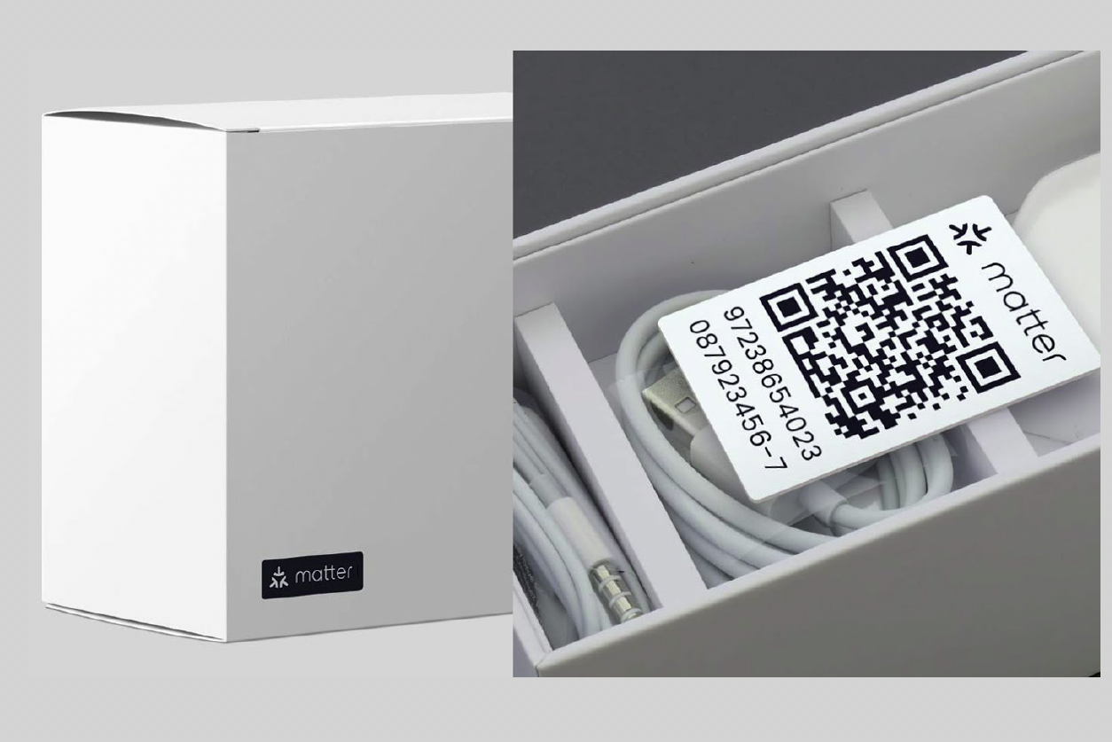
How We Stack Up
Common application layer + data model Interoperability, simplified setup & control
IP-based Convergence layer across all compatible networks
Secure AES-128-CCM encryption with 128-bit AES-CBC
Open-source development approach Based on market-proven technologies
Common protocol across device and mobile Extensible to cloud
Common data model Core operational functions, multiple device types
Low overhead MCU-class compute, <128KB RAM, <1MB Flash

Slide 49


Creating Experiences that Matter
Consumers
More consistent set up experience
Multi –Admin works across & with multiple ecosystems
Developers
Develop once / deploy everywhere
Secure-by-design approach
Community of support
Retailers
Simplified purchasing experience
Minimized returns
Commercial / Builders
Future proofed ecosystem compatibility
Flexibility for users

Slide 50
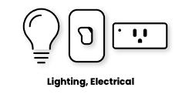
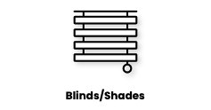
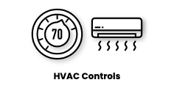
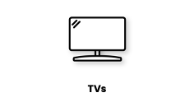
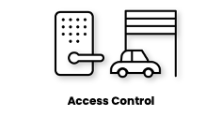
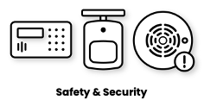


Target Device Types
Lighting, Electrical
Blinds/Shades
HVAC Controls
TVs
Access Control
Safety & Security
Access Points, Bridges
Matter controllers can be implemented in a variety of devices and interfaces
Scoping exercises for additional device types and use cases underway and continual.

Slide 51


Open Source
Matter open source project:
github.com/project-chip/connectedhomeip
Collaborative, open-source development
Accessible, transparent, robust, and secure. Code examples showing interactions on multiple transports.
Built on market-proven technologies
Companies from across the industry are contributing market-proven technologies and best practices.
Implementation-first approach
Growing to implement the overall architecture. Not just a technical spec, but deployable code.

Slide 52

Matter communication architecture
Multiple Phy/Link layers: Ethernet, WiFi, or Thread
IPv6 networking
Multiple transport layers
TCP or UDP. Custom BLE layer for device setup only

Slide 53


Matter networks
Use border routers to communication across networks

Slide 54
Interoperability between devices
Always an IoT challenge!
Matter uses Zigbee device library
Akin to BLE GATT device standards
BLE Profile
BLE Service
BLE Characteristic
ZigBee Profile + Device Type
ZigBee Cluster
ZigBee Attribute
Also ~ZigBee Commands

Slide 55
Security: major emphasis for Matter
Promote security by default
Standard and software stacks handle
Commissioning
Setting up security certs
“Fabric”: logical set of devices that share a security domain and can communicate
Devices in Matter can support “multi-fabric”
This would enable connecting device ecosystems together
Does have to be implemented though…

Slide 56








Matter Commissioning – User View
Wi-Fi Router
Commissioner
Light Switch
Factory
Store
Device is manufactured and shipped
User brings Device to Smart Home
User intros Device to Commissioner (Tablet, Phone, Smart Speaker, etc.)
User initiates commissioning
Device is commissioned
Device operates smoothly in Smart Home
Thread Border Router

Slide 57

More on Matter
https://www.youtube.com/watch?v=v_285vCHifw
https://www.nordicsemi.com/products/matter
https://xkcd.com/927/

